Slide 1
Chapter 7
E-Supply Chains, Collaborative Commerce, and Corporate Portals

Slide 2
Learning Objectives
Define the e-supply chain and describe its characteristics and components.
List supply chain problems and their causes.
List solutions to supply chain problems provided by EC.
Describe RFID supply chain applications.
Define c-commerce and list the major types.

Slide 3
Learning Objectives
Describe collaborative planning and Collaboration, Planning, Forecasting, and Replenishing (CPFR) and list the benefits of each.
Discuss integration along the supply chain.
Understand corporate portals and their types and roles.
Describe e-collaboration tools such as workflow software and groupware.

Slide 4
E-Supply Chains
Definitions and Concepts
  supply chain
  The flow of materials, information, money, and services from raw material suppliers through factories and warehouses to the end customers
  e-supply chain
  A supply chain that is managed electronically, usually with Web technologies

Slide 5
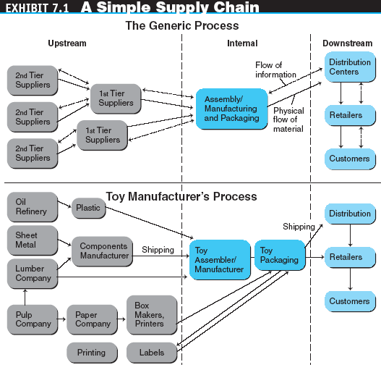
E-Supply Chains

Slide 6
E-Supply Chains
Supply Chain Parts
  Upstream supply chain
    procurement
    The process made up of a range of activities by which an organization obtains or gains access to the resources (materials, skills, capabilities, facilities) they require to undertake their core business activities
  Internal supply chain
  Downstream supply chain

Slide 7
E-Supply Chains
supply chain management (SCM)
A complex process that requires the coordination of many activities so that the shipment of goods and services from supplier right through to customer is done efficiently and effectively for all parties concerned. SCM aims to minimize inventory levels, optimize production and increase throughput, decrease manufacturing time, optimize logistics and distribution, streamline order fulfillment, and overall reduce the costs associated with these activities

Slide 8
E-Supply Chains
e-supply chain management (e-SCM)
The collaborative use of technology to improve the operations of supply chain activities as well as the management of supply chains
The success of an e-supply chain depends on:
  The ability of all supply chain partners to view partner collaboration as a strategic asset
  A well-defined supply chain strategy
  Information visibility along the entire supply chain
  Speed, cost, quality, and customer service
  Integrating the supply chain more tightly

Slide 9
E-Supply Chains
Activities and infrastructure of E-SCM
  Supply chain replenishment
  E-procurement
  Supply chain monitoring and control using RFID
  Inventory management using wireless devices
  Collaborative planning
  Collaborative design and product development
  E-logistics
  Use of B2B exchanges and supply webs

Slide 10
E-Supply Chains
e-procurement
The use of Web-based technology to support the key procurement processes, including requisitioning, sourcing, contracting, ordering, and payment. E-procurement supports the purchase of both direct and indirect materials and employs several Web-based functions such as online catalogs, contracts, purchase orders, and shipping notices
collaborative planning
A business practice that combines the business knowledge and forecasts of multiple players along a supply chain to improve the planning and fulfillment of customer demand

Slide 11
E-Supply Chains
Infrastructure for e-SCM
  Electronic Data Interchange (EDI)
  Extranets
  Intranets
  Corporate portals
  Workflow systems and tools
  Groupware and other collaborative tools

Slide 12
E-Supply Chains
Determining the Right Supply Chain Strategy
  Functional products are staple products that have stable and predictable demand and call for a simple, efficient, low-cost supply chain
  Innovative products tend to have higher profit margins, volatile demand, and short product life cycles. These products require a supply chain that emphasizes speed, responsiveness, and flexibility rather than low costs

Slide 13
Supply Chain
Problems and Solutions
Typical Problems along the Supply Chain
  With increasing globalization and offshoring, supply chains can be very long and involve many internal and external partners located in different places
  A lack of logistics infrastructure might prevent the right goods from reaching their destinations on time
  Quality problems with materials and parts also can contribute to deficiencies in the supply chain
  bullwhip effect
  Erratic shifts in orders up and down supply chains

Slide 14
Supply Chain
Problems and Solutions
The Need for Information Sharing along the Supply Chain
EC Solutions along the Supply Chain
  Order taking
  Order fulfillment
  Electronic payments
  Managing risk
  Inventories can be minimized
  Collaborative commerce

Slide 15
Key Enabling Supply Chain
Technologies: RFID and Rubee
radio frequency identification (RFID)
Tags that can be attached to or embedded in objects, animals, or humans and use radio waves to communicate with a reader for the purpose of uniquely identifying the object or transmitting data and/or storing information about the object

Slide 16
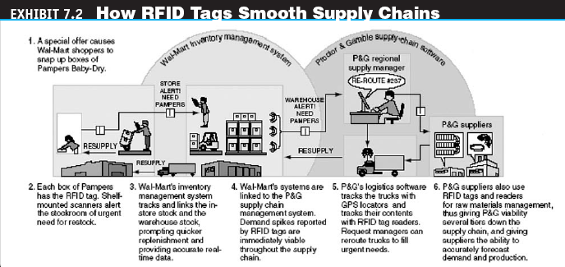
Key Enabling Supply Chain
Technologies: RFID and Rubee

Slide 17
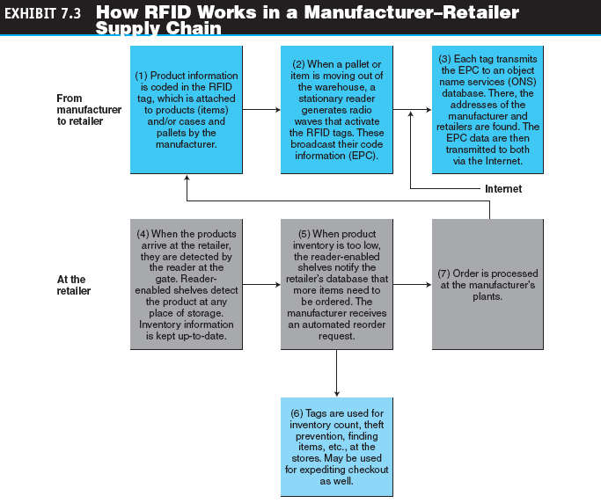
Key Enabling Supply Chain
Technologies: RFID and Rubee

Slide 18

Key Enabling Supply Chain
Technologies: RFID and Rubee

Slide 19
Key Enabling Supply Chain
Technologies: RFID and Rubee
LIMITATIONS OF RFID
  For small companies, the cost of the system may be too high
  The restriction of the environments in which RFID tags are easily read
  Different levels of read accuracy at different points along the supply chain
  Concerns over customer privacy
  Agreeing on universal standards
  Connecting the RFIDs with existing IT systems

Slide 20
Key Enabling Supply Chain
Technologies: RFID and Rubee
RuBee
Bidirectional, on-demand, peer-to-peer radiating transceiver protocol under development by the Institute of Electrical and Electronics Engineers

Slide 21
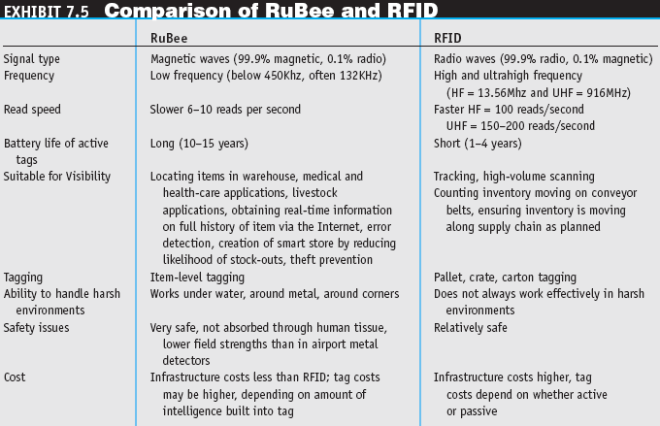
Key Enabling Supply Chain
Technologies: RFID and Rubee

Slide 22
Collaborative Commerce
collaborative commerce (c-commerce)
The use of digital technologies that enable companies to collaboratively plan, design, develop, manage, and research products, services, and innovative EC applications
collaboration hub
The central point of control for an e-market. A single c-hub, representing one e-market owner, can host multiple collaboration spaces (c-spaces) in which trading partners use
c-enablers to exchange data with the c-hub

Slide 23
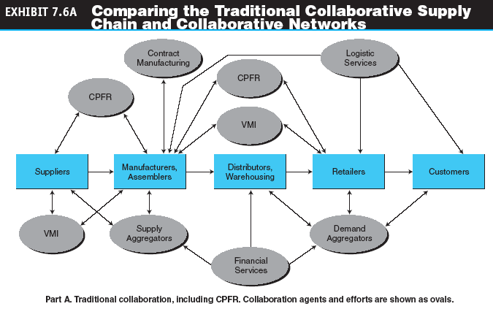
Collaborative Commerce

Slide 24
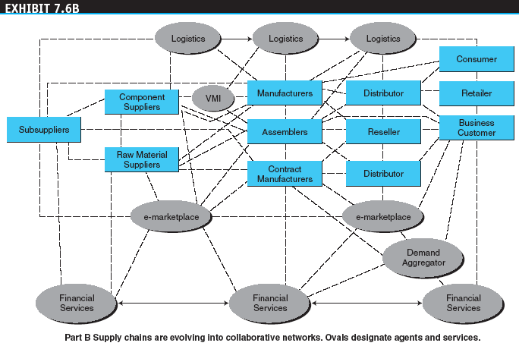
Collaborative Commerce

Slide 25
Collaborative Commerce
grid computing
A form of distributed computing that involves coordinating and sharing computing, application, data, storage, or network resources across dynamic and geographically dispersed organizations
service-oriented architecture (SOA)
An architectural concept that defines the use of services to support a variety of business needs. In SOA, existing IT assets (called services) are reused and reconnected rather than the more time consuming and costly reinvention of new systems

Slide 26
Collaborative Commerce
Representative Examples of
E-Collaboration
  vendor-managed inventory (VMI)
  The practice of retailers’ making suppliers responsible for determining when to order and how much to order
  Information sharing between retailers and suppliers
  Retailer–supplier collaboration
  Lower transportation and inventory costs and reduced stockouts
  Reduction of design cycle time
  Reduction of product development time

Slide 27
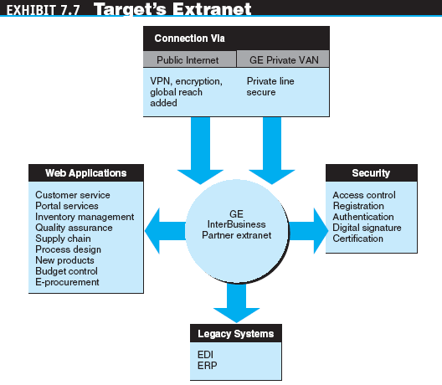
Collaborative Commerce

Slide 28
Collaborative Commerce
Barriers to C-Commerce
  Most organizations have achieved only moderate levels of collaboration because of:
    A lack of internal integration, standards, and networks
    Security and privacy concerns, and distrust over who has access to and control of information stored in a partner’s database
    Internal resistance to information sharing and to new approaches
    A lack of internal skills to conduct c-commerce

Slide 29
Collaborative Planning, CPFR, and Collaborative Design
collaborative planning, forecasting, and replenishment (CPFR)
Project in which suppliers and retailers collaborate in their planning and demand forecasting to optimize flow of materials along the supply chain

Slide 30
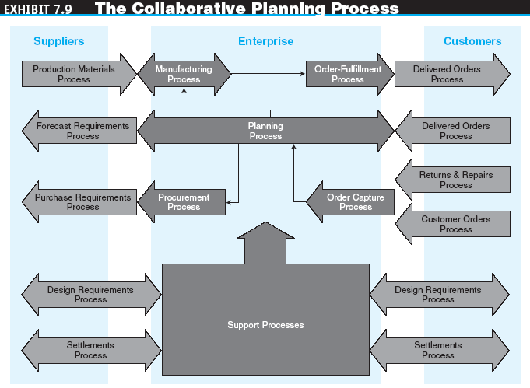
Collaborative Planning, CPFR, and Collaborative Design

Slide 31
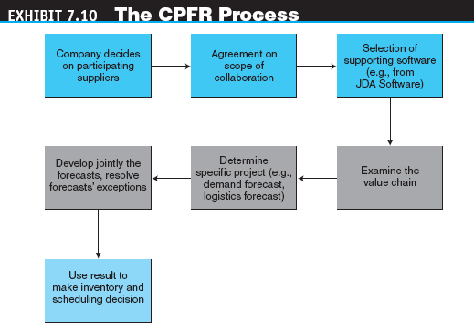
Collaborative Planning, CPFR, and Collaborative Design

Slide 32
Collaborative Planning, CPFR, and Collaborative Design
advanced planning and scheduling (APS) systems
Programs that use algorithms to identify optimal solutions to complex planning problems that are bound by constraints

Slide 33
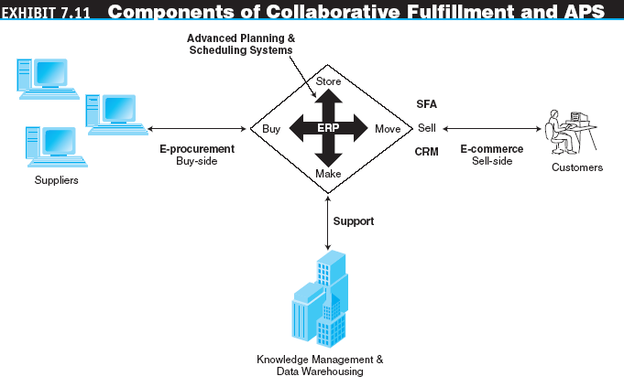
Collaborative Planning, CPFR, and Collaborative Design

Slide 34
Collaborative Planning, CPFR, and Collaborative Design
product lifecycle management (PLM)
Business strategy that enables manufacturers to control and share product-related data as part of product design and development efforts

Slide 35
Supply Chain Integration
How Information Systems Are Integrated
  Internal integration includes connecting applications with databases and with each other and connecting customer-facing applications (front end) with order fulfillment and the functional information systems (back end)
  Integration with business partners connects an organization’s systems with those of its external business partners

Slide 36
Supply Chain Integration
Web Services
An architecture enabling assembly of distributed applications from software services and tying them together
Integration along the Extended Supply Chain
  Information integration along the extended supply chain—all the way from raw material to the customer’s door

Slide 37
Corporate (Enterprise) Portals
corporate (enterprise) portal
A gateway for entering a corporate Web site, enabling communication, collaboration, and access to company information

Slide 38
Corporate (Enterprise) Portals
Types of Corporate Portals
  Types of generic portals
    Portals for suppliers and other partners
    Customer portals
    Employee portals
    Executive and supervisor portal
    mobile portals
    Portals accessible via mobile devices, especially cell phones and PDAs

Slide 39
Corporate (Enterprise) Portals
  The Functionalities of Portals
    information portals
    Portals that store data and enable users to navigate and query these data
    collaborative portals
    Portals that allow collaboration

Slide 40
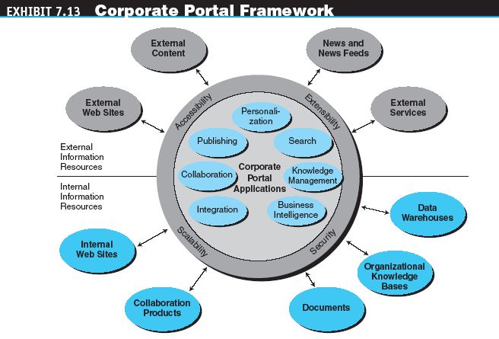
Corporate (Enterprise) Portals

Slide 41
Corporate (Enterprise) Portals
Justifying Portals
  Portals offer benefits that are difficult to quantify
Developing Portals
  Many vendors offer tools for building corporate portals as well as hosting services

Slide 42
Collaboration-Enabling Tools:
From Workflow to Groupware
Workflow Technologies and Applications
  workflow
  The movement of information as it flows through the sequence of steps that make up an organization’s work procedures
  workflow systems
  Business process automation tools that place system controls in the hands of user departments to automate information processing tasks
  workflow management
  The automation of workflows, so that documents, information, and tasks are passed from one participant to the next in the steps of an organization’s business process

Slide 43
Collaboration-Enabling Tools:
From Workflow to Groupware
Types of Workflow Applications
  Collaborative workflow
  Production workflow
  Administrative workflow
The benefits of workflow management systems include:
  Cycle time reduction
  Productivity gains
  Improved process control
  Improved quality of services
  Lower staff training costs
  Lower management costs
  Improved user satisfaction
  More effective collaboration and knowledge sharing

Slide 44
Collaboration-Enabling Tools:
From Workflow to Groupware
groupware
Software products that use networks to support collaboration among groups of people who share a common task or goal
Synchronous versus Asynchronous Products

Slide 45
Collaboration-Enabling Tools:
From Workflow to Groupware
Electronic Meeting Systems
  virtual meetings
  Online meetings whose members are in different locations, even in different countries
  group decision support system (GDSS)
  An interactive computer-based system that facilitates the solution of semistructured and unstructured problems by a group of decision makers

Slide 46
Collaboration-Enabling Tools:
From Workflow to Groupware
Electronic Teleconferencing
teleconferencing
The use of electronic communication that allows two or more people at different locations to have a simultaneous conference

Slide 47
Collaboration-Enabling Tools:
From Workflow to Groupware
video teleconference
Virtual meeting in which participants in one location can see participants at other locations on a large screen or a desktop computer
data conferencing
Virtual meeting in which geographically-dispersed groups work on documents together and exchange computer files during videoconferences

Slide 48
Collaboration-Enabling Tools:
From Workflow to Groupware
Voice-over-IP (VoIP)
Communication systems that transmit voice calls over Internet Protocol–based networks
Interactive whiteboards
screen-sharing software
Software that enables group members, even in different locations, to work on the same document, which is shown on the PC screen of each participant

Slide 49
Collaboration-Enabling Tools:
From Workflow to Groupware
Instant video
Integration and groupware suites
  Lotus Notes/Domino
  Microsoft NetMeeting
  Novell GroupWise

Slide 50
Managerial Issues
How difficult is it to introduce e-collaboration?
How much can be shared with business partners? Can they be trusted?
Who is in charge of our portal and intranet content?
Who will design the corporate portal?
Should we conduct virtual meetings?

